Slide 1
Support for Special Educators Survey: Key Findings
August 22, 2017

Slide 2
Discussion Topics
Background
Survey Purpose
Key Findings
Distribution Plan
Notes:
This presentation describes findings from a survey about special and general educators perceptions of practices that pertain to special educations services in the WCSD.
The full summary report can be accessed at https://www.washoeschools.net/site/Default.aspx?PageType=7&SiteID=4

Slide 3
Contextual Background
Focused attention on improving outcomes for students with disabilities
Momentum in the WCSD toward solutions to persistent challenges, in partnership with parents and educators.
Stetson Report 2011
Key Performance Data Reports 2014 & 2016
Town Hall Events 2015
West Ed Recommendations 2015
All Children Matter 2016
Special Education Advisory Panel 2016
Notes:
In recent years there have been efforts investigate why students with disabilities in our district are not achieving to the levels we would expect. We want to know where we are failing our students so that we can strengthen our system and improve student outcomes.
In line with these efforts we wanted fill-in some of the gaps in our information about the specific practices that surround special education services – We chose to survey our educators to get their perspectives to help us with this.

Slide 4
Survey Purpose
Capture a fuller picture of the practices that affect the delivery of SPED services
Learn from educators how to improve the delivery of SPED services
Establish how educators’ time is used and the level of their workloads
Notes:
There were three primary goals we had at the outset in developing this survey. Each of them stemmed from conversations we had about the evaluation priorities for Student Services and to also support other departments whose work directly touches students with disabilities, such as MTSS and the ESL departments.
We had also been hearing from various groups about some challenges that are likely to affect how special education services are delivered and received. For example, anecdotal information from school psychologists suggested that IATs and IEP teams sometimes… We wanted to confirm whether this perception is also held by educators within schools.

Slide 5
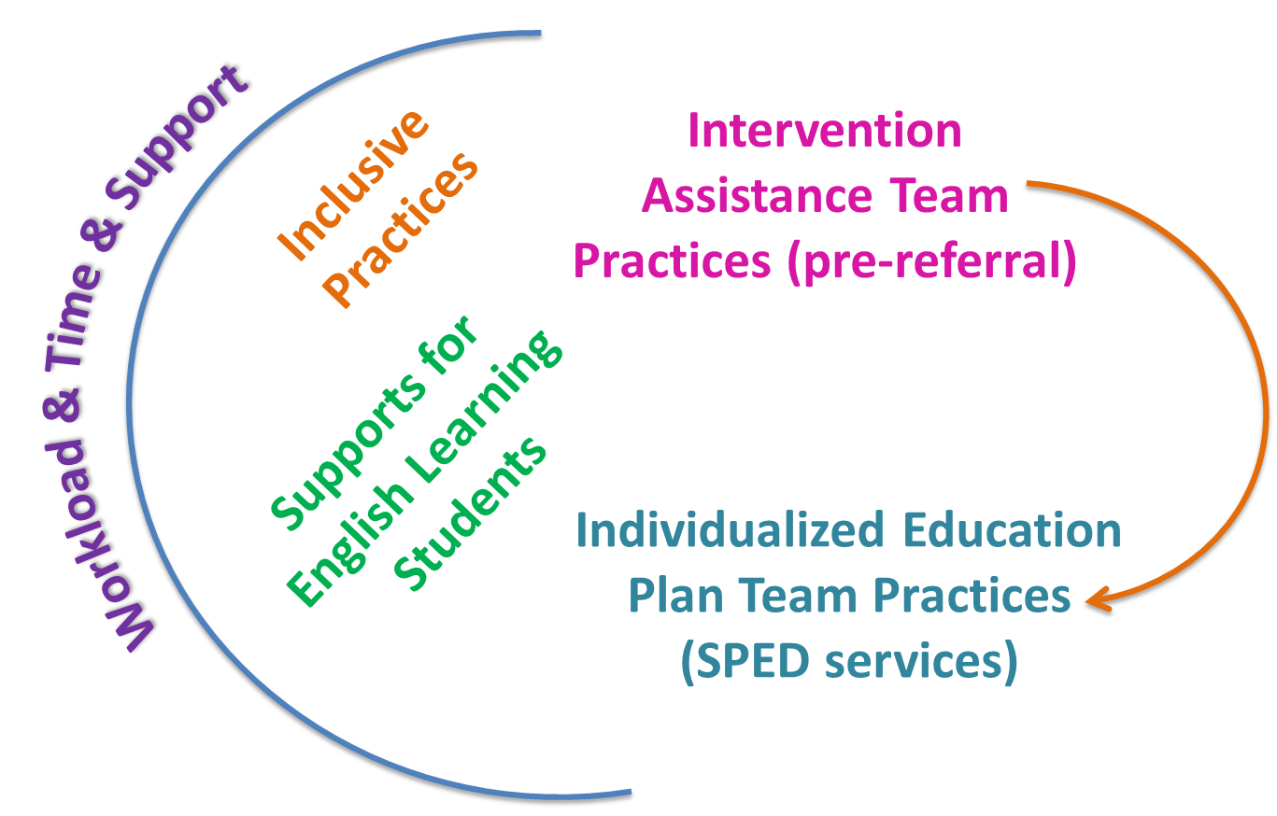
Survey Purpose
Notes:
Five areas explored by the survey that each reflect an aspect of special education as perceived by general educators and special educators. These areas include:
IAT practices that relate to the pre-referral process. This team is the primary mechanism by which students in need of sped services are identified and referred for comprehensive evaluation for eligibility.
IEP team practices, whereby the oversight of students’ IEP are managed and implemented.
Inclusive practice affects all students and its implementation is critical to ensuring students with disabilities access the core curriculum at the same high quality levels of instruction that their non-disabled peers experience
Supports for English learners within the IAT and IEP team processes ensure EL students with disabilities receive the often more complex levels of support required to meet their literacy and specialized learning goals
Finally, teacher workloads, time, and supports affects their ability to engage in each of the areas just mentioned and is important to the

Slide 6
Survey Purpose
Establishes a baseline of WCSD educator perceptions of SPED practices
Provides information from which professional development can be developed
Pushes dialogue and reflection
Notes:
There is strong interest in this survey and an appetite to use the information to inform PLC work. I have received requests for the summary.

Slide 7
Survey Participation
Strong response rate (43%, 799 of 1876)
209 special education teachers
483 general education teachers
29 gen ed staff and 65 spec. ed. staff
13 excluded
Representative of special educators at 99% confidence level, + 6.72
Representative of general educators at the 99% confidence level, + 5.21
Notes:
Half of all certified teachers were randomly selected to take this survey. It was completely anonymous and is not tied to schools.

Slide 8
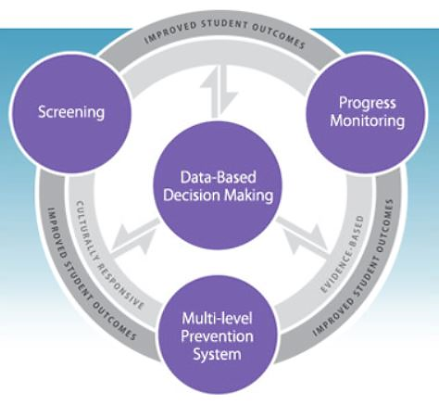
Intervention Assistance Team (IAT) Practices
Evaluation Question:
To what extent are IATs adhering to best practices for identifying students for referral for special education services?
Notes:
MTSS is the evaluation strategy for determining specific learning disabilities. The IAT is the central mechanism for monitoring students, their response to interventions, and the coordination of services and is responsible for making the decision to refer for comprehensive evaluation for SPED services.
14 items were included in the survey to capture the perception of implementation of RtI practices, practices pertaining to referral for special services, and supports for English Learners. These items were available only to people who indicated they had served on an IAT this school year (n=164). 103 gen ed teachers, 33 special ed teachers and 28 non-teaching positions.
Evaluation Questions: To what extent are IATs using data and grade level standards to make decisions, goals, and benchmarks? How frequently and effectively do schools integrate academic and behavioral data? EL best practice?

Slide 9
IAT Practices
Majority of IAT members indicate RtI best practices are followed
diminishes from ES to MS to HS
Before referral is made:
79% say a range of interventions are attempted
71% say exclusionary factors are considered as the primary causes of academic deficits
General educators believe their school’s IAT adheres to best practice significantly more than do special educators.
Notes:
RtI best practice includes making decisions based on student performance data (79%), using research-based interventions (74%), and assessing student progress frequently (70%)
Less than a quarter (23%) of high school teachers believe sufficient time for tier 2 and 3 interventions is given for progress to be assessed.
The last two points are important for accurate referral for SPED evaluation.

Slide 10
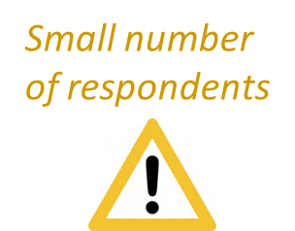
IAT Practices
8% (12 of 149) say there is sometimes pressure to refer students for SPED services when there is doubt a student has a disability
Others believe students are under-referred
11% (16 of 149) say exclusionary factors are not considered before referral is made
Special educators believe there is pressure to identify and exclusionary factors are not considered significantly more than do general educators.
Notes:
Small number of people, but have heard this anecdotally in other settings: (8% = 12 of 149) (11%, 16 of 149)
Differences between special and gen ed teachers are large: 19% (6 of 31) for both among special educators compared to 4% (4 of 91) and 6% (5 of 91) among gen ed.
They explained the pressure to identify students for special education is motivated by:
Wanting to ensure struggling students receive services or extra support.
Lack of ability among some teachers to differentiate or teach challenging students.
Disability appears to be the only cause when instruction and interventions do not improve learning.

Slide 11
IAT Practices
Most IAT members believe:
English acquisition issues are ruled out before referral for SPED evaluation is made (67%)
IAT members have expertise relevant to cultural and linguistic differences of English learning students (62%)
ESL teachers are always part of any IAT that supports an EL student (58%)
Literacy development and special education services are fully integrated at their school (53%)
Notes:
Comments about the pre-referral of EL students for special education services suggest several challenges, including insufficient knowledge among personnel who are involved in identification, difficulties providing consistent, adequate services to students who are ELs, and lack of collaborative structures in pre-referral.
The integration of literacy development throughout the educational experience is important because language is an integration of the processes of listening, speaking, reading, and writing. Each are inextricably inter-related.

Slide 12
IAT Practices
Teacher recommendations:
Collaboration between ESL and special educators
PD about English language acquisition for all teachers
Consistent and effective instruction for EL students pre and post referral for SPED services
Notes:
Suggestions were specifically asked about support EL students. Other suggestions also emerged from open comments, although they do not specifically directed at IAT practices.

Slide 13
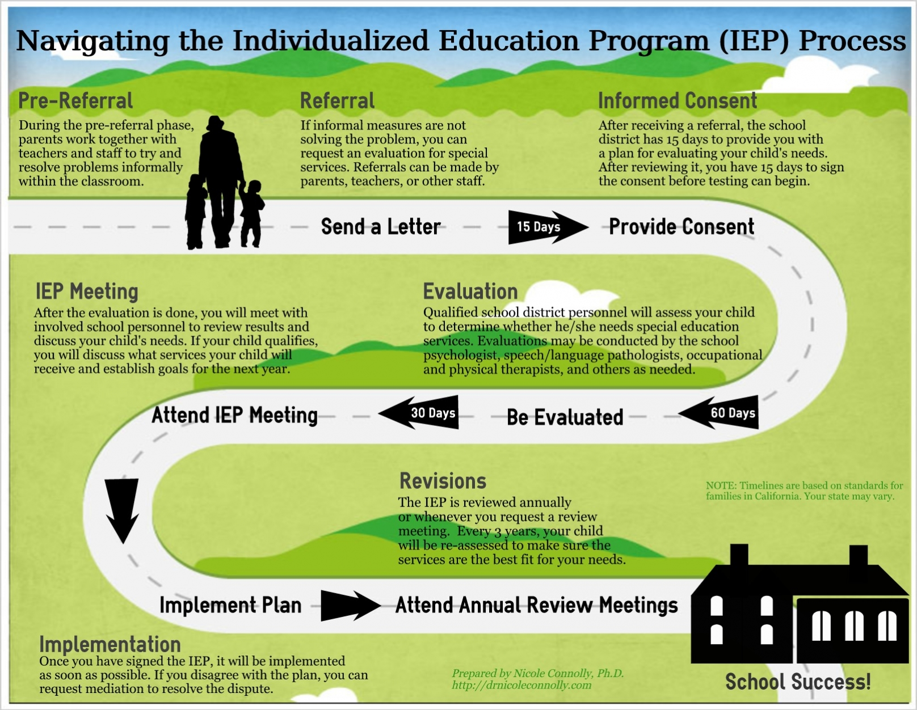
Individualized Education Plan (IEP) Team Practices
Evaluation Question:
To what extent are IEP teams using data and grade level standards to make decisions, goals, and benchmarks?
Notes:
Seven items were included in the Support for Special Educators Survey to explore the degree to which IEP teams engage in certain practices for supporting IEPs. Three areas of IEP practice were explored, including use of data in decision-making, student voice, and support for ELs.
These items were available to special and general educators in teaching and non-teaching positions who indicate they served on an IEP team the current school year (n=626). Of them, 359 are general education teachers, 197 are special education teachers, 13 in general education non-teaching roles, and 57 in special education non-teaching roles.
Evaluation Questions: To what extent are IEP teams using data and grade level standards to make decisions, goals, and benchmarks? How frequently and effectively do schools integrate academic and behavioral data? To what extent are “fidelity checks” completed (frequency, by whom, what practices) to determine whether effective problem-solving models, assessment best practices, and SPED guidelines are in place? EL best practice for support?

Slide 14
IEP Team Practices
When making decisions & setting goals, most believe the IEP team:
refers to grade level standards (76%)
uses data (82%)
considers academic & behavior data (80%)
Special educators agree at significantly higher rates than do general educators that these practices occur

Slide 15
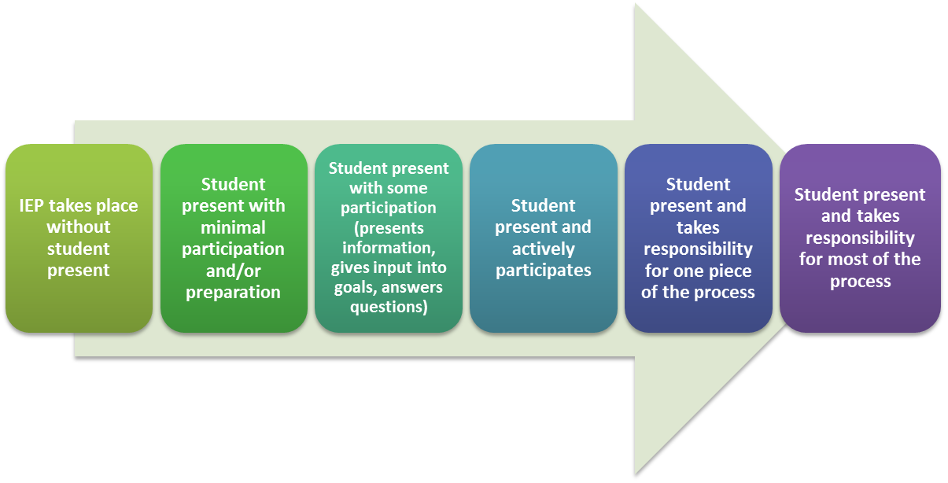
IEP Team Practices
56% of special education teachers and 43% of gen ed teachers say students have opportunities to contribute to their IEPs
Source: Student-led IEP Toolkit, District of Columbia Office of State Superintendent of Education’s Division of Secondary Transition
Notes:
From OSSE http://dc-transition_guide.frameweld.com/page/studentled_iep_toolkit_introduction
Student participation throughout the process should be individualized and based on age, needs, and abilities of the students” OSSE Secondary Transition Website

Slide 16
IEP Team Practices
60% say IEP members have expertise relevant to cultural and linguistic differences of students who are learning English
40% say ESL teachers are part of teams that support EL students

Slide 17
IEP Team Practices
Teacher recommendations:
Collaboration gen. ed, SPED & ESL, PD for all staff, & high quality instruction for EL students
Student Service staff attend IEP meetings, especially when contentious (SE only)
Increase consistency of quality IEPs across schools (SE only)
Notes:
Consistent with recommendations from IAT members:
Collaboration between ESL and special educators
PD about English language acquisition for all teachers
Effective and consistent instruction for EL students pre and post referral for SPED services

Slide 18
Inclusive Practice
Evaluation Question:
What are teacher
attitudes towards inclusive practice for students with disabilities?
Notes:
Fourteen (14) items were included in this survey to examine teachers’ attitudes towards inclusion, issues teachers face when implementing inclusive practices, and how teachers feel inclusion is affecting learning among students in their classrooms. These items, or statements, were adapted from the Inclusion Questionnaire for Educators (Salend, 1999; Hwang & Evans, 2011). Teachers were asked to respond to each statement using a Likert scale from 1 (strongly disagree) to 5 (strongly agree).
Teacher attitude toward inclusion is a contributing factor to its success or failure. It is important to identify which aspects of the process are working and which aspects are perceived as barriers from the teacher perspective so that improvements can be made. This information is intended to support a smooth and effective implementation of inclusion.
Evaluation Question: What are the contributors that limit or enhance inclusion for students with disabilities across schools?

Slide 19
Inclusive Practice
Most teachers believe inclusion is a good idea
74% of gen ed teachers feel competent to educate students with disabilities & 88% know the IEP goals of all their students
But
82% report having difficulty meeting the needs of all of their students
30-35% say they have enough time, support, and resources to implement inclusive practice
Notes:
The belief that inclusion is a good idea is strongest among special educators (83%), middle (79%) and high school (77%) teachers, and novice teachers (77%). Interestingly, novice teachers were also most likely to say that they experience greater enjoyment of teaching as a result of inclusion than were teachers who have been around longer.
There are a number of challenges expressed by survey respondents about inclusion.

Slide 20
Inclusive Practice
58% believe inclusion helps students with disabilities improve academically
52% of gen ed teachers say inclusion is working well in their classrooms
40% say students with disabilities often experience failure and frustration in gen ed
77% believe students with disabilities who have behavior challenges disrupt the learning of other students
Notes:
The belief that inclusion helps students improve academically and that inclusion is working well is strongest among special educators and teachers in high school.
Educators describe their belief that inclusion is valuable for many students, however, they caution that the practice poses challenges that can inhibit the learning of all students if done incorrectly. Several of them asked that the District be mindful of the push for inclusion and consider easing the expectation for full inclusion.

Slide 21
Inclusive Practice
Teacher recommendations:
Develop a clear plan to ensure students succeed in inclusive settings
Provide additional staff to support inclusive practices
Offer more training to staff about educating students with disabilities
Provide full inclusion for only those students it is appropriate for
Notes:
For the last recommendation, number 4, teachers stress that they also want there to be increased focus on accurate determination of who inclusion is appropriate for and who can be better served in self-contained classrooms.

Slide 22
Discussion Questions
What questions does this information raise?
How can this information be used to improve delivery of special education services…
By school staff (e.g., administrators, problem-solving teams, educators)?
By district staff (e.g., implementation specialists, consulting teachers, leadership)?
Notes:
Discussion partner
Write one question you have and one suggestion for how it can be used on sticky notes
Call on 1-2 people
Collect sticky notes on chart paper – will summarize and use for
Hoping this presentation prompts your interest in reading the full report!
E.g., Does the master schedule support collaboration between special educators, English as a second language (ESL) specialists, and general educators?

Slide 23
Workload and Time
Evaluation Question: To what extent do educators feel their workloads are manageable?
Notes:
The extent to which educators feel their workload is manageable is related to stress, job satisfaction, and burnout. Furthermore, students of stressed or exhausted teachers are frequently disruptive, struggle socially and emotionally, and attain their IEP goals less frequently than students whose teachers are less stressed.
Educators were asked to provide details about the students they teach and support. Additionally, special educators were asked to describe the number of students they case manage and the amount of time they dedicate to activities that surround special education referral.
These items were available to special and general educators in teaching and non-teaching positions who indicate they served on an IEP team this year (n=689). Of them, 440 are general education teachers, 169 are special education teachers, 29 in general education non-teaching roles, and 51 in special education non-teaching roles.

Slide 24
Workload and Time
Most teach 25+ students
53% of SPED and 36% of gen ed teachers have 10+ students who belong to 2+ spec pops
27% teach 10+ students with multiple disabilities: 69% among special educators in non-teaching roles
51% of special educators case manage 20+ students
One-fifth with multiple disabilities
Notes:
Heavily impacted

Slide 25
Notes:
Bulk of time is spent performing on-going assessment (65%).
Pre-referral activities include consulting with IAT members and general education teachers about students
Referral includes interactions with IAT members, possibly explaining assessment results
Initial assessment includes implementing SPED eligibility assessments – school psychologist
On-going assessment activities include choosing assessment based on students needs, implementing basic skills assessments, functional and skills assessments.
In future would ask for a more complete picture of the roles of SE, such as providing PD, instructional coaching, consulting with students, parent, school, and community, interventionist, diagnostician, and manager work. Mitchell 2011 to see how their roles fit within the RTI framework.

Slide 26
Notes:
Over 1-third (34%) of special education teachers say their workloads are not manageable.

Slide 27
Workload and Time
Teacher recommendations:
Efficient scheduling & increased planning time
Reduction of demands not related to teaching
Refine push-in support: less distracting, more integrated
More resources & support to meet wide-ranging needs of students
Increased collaboration between gen ed and SPED teachers
Notes:
Teachers offered many actionable solutions.

Slide 28
Workload and Time
Special Educator recommendations:
Assign caseloads based on student needs rather than number of students CMs expected to serve
Increase amount of accessible curriculum – less reliance on SPED staff adapting existing curriculum
More adult support
Notes:
Teachers explain that the additional support is needed for them to fulfill their obligations to both case manage and teach. Teachers envision utilizing additional aides and other para-professionals for assistance with:
Completing paperwork and filing
Administering tests and assessments
Supporting data collection and monitoring for IEP
Scheduling

Slide 29
Support for Special Educators
Evaluation Question: Do special education staff feel supported across aspects of special education practice? In what areas do they feel well-supported and what areas would they like more support?
Notes:
Twelve (12) items were included in the Support for Special Educators Survey to examine the level to which special educators feel supported in their positions, to gather their feedback about the challenges they encounter, and obtain suggestions they have to improve support for special education services in the WCSD.
These items were available to special educators only. Of those who responded (n=230), 180 of them are special education teachers and 49 of them are special educators in non-teaching positions. This information is intended to be used to better understand how special educators feel about the quality and type of support provided by Student Services so that changes can be monitored as the system for support is honed over time.
Stemmed in part from low teacher morale expressed at Town Hall meetings, also, need to tackle head on to address teacher retention. National crisis.
Evaluation question: Do special education staff feel supported across aspects of special education practice? In what areas do they feel well-supported and what areas would they like more support?

Slide 30
Support for Special Educators
Most feel SPED services are supported at their school:
76% say there is cooperative efforts among staff
76% say SPED is integrated within school system
District support is perceived as lacking:
46% say they are provided compliance support
41% say they are provided with IEP support
40% feel their instructional practices are supported by Student Services
Notes:
Belief that SPED services are supported within their schools is strongest among ES and lowest among MS.
Generally, special educators in middle school feel less supported than their elementary and high school counterparts. Special educators who serve multiple schools rate the support provided by Student Services at the lowest levels.
Differences across school levels and items may be attributed, in part, to varying levels of support provided by specific positions to special education teachers. For example, IS support from Student Services is primarily targeted to elementary schools and so lower ratings of agreement about IS support at middle and high school is expected.

Slide 31
Support for Special Educators
Teacher recommendations:
Promote a culture of respect
Ensure transparent & cohesive communication with special educators
Listen to & rely on school staff to find solutions
Afford teachers & aides adequate & fair compensation
Provide support & resources to perform their position duties effectively
Notes:
Suggestions were specifically asked about support EL students. Other suggestions also emerged from open comments, although they do not specifically directed at IAT practices.

Slide 32
Support for Special Educators
Teacher recommendations:
Provide onsite trainings, direct support (e.g., mentors & coaches), & specialized trainings
Increase onsite visits & responsiveness by Student Service staff
Add moderate program: between CLS & gen ed
Provide training about new practices, policies, and procedures
Ask for & utilize staff input on implementation of policies & procedures
Notes:
– Offer to all school staff
-- More support for new SPED staff w/less reliance on other special educators
– provide direct-line support (not go through principal)

Slide 33
Planning for Improvement
Within your professional role, what can you do to contribute to improvement?
Place a next to three suggestions offered by educators you see as top priorities.
Then, choose one of those priorities and write two actions you will take toward supporting that suggestion.

Slide 34
Thank you!
Jennifer Harris
Program Evaluator
(775)333-3766
jharris@washoeschools.net
Washoe County School District
Office of Accountability
425 East Ninth Street
Reno, NV 89520

